Slide 1
Today’s topic
Central dogma of life

Slide 2
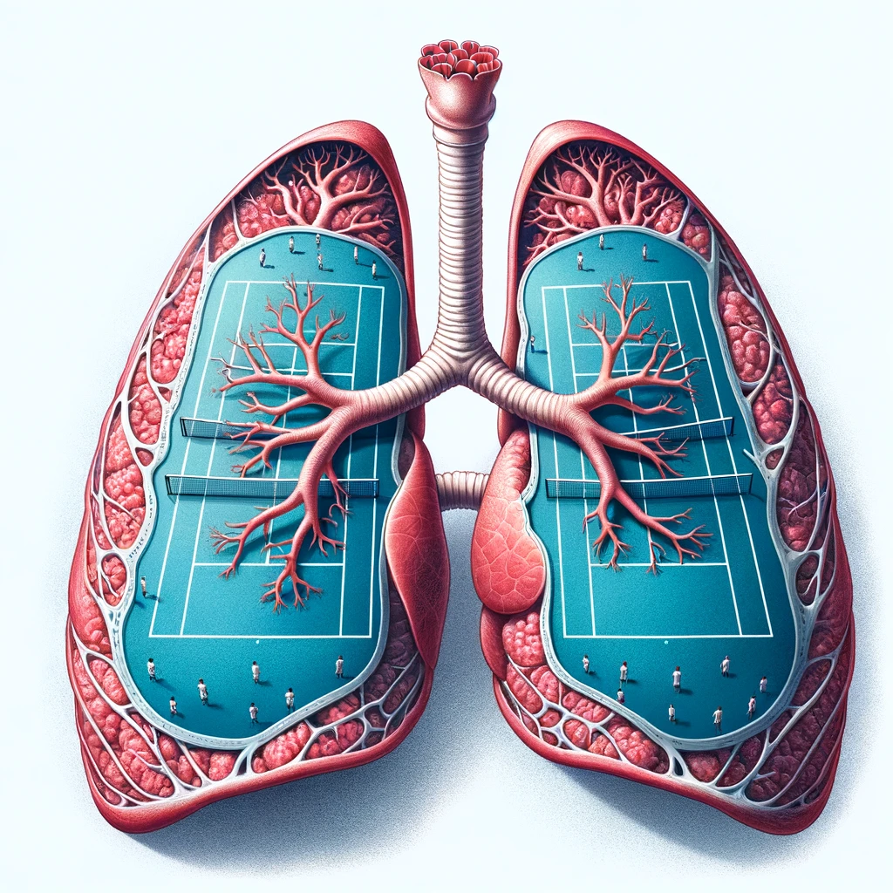

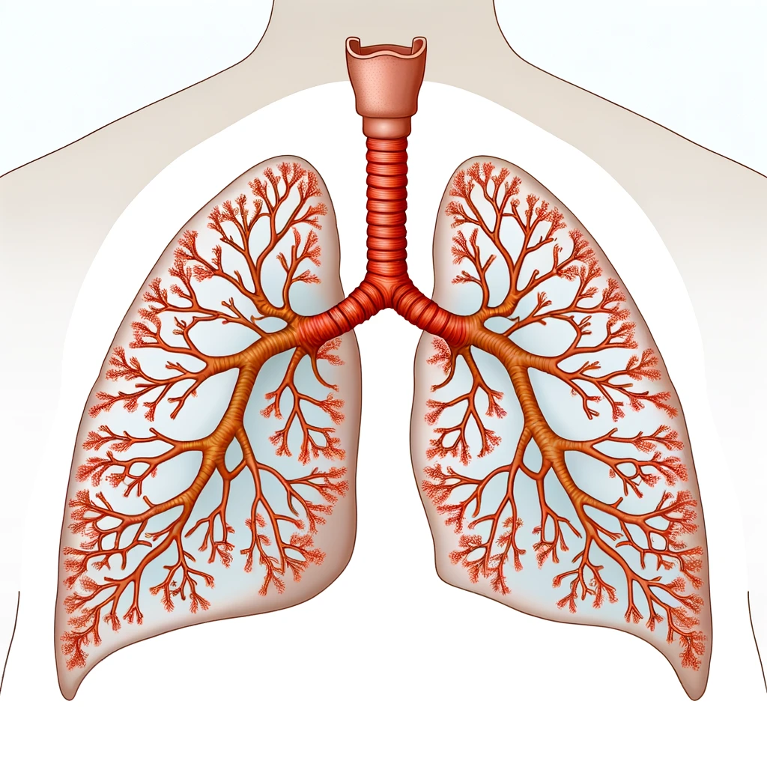

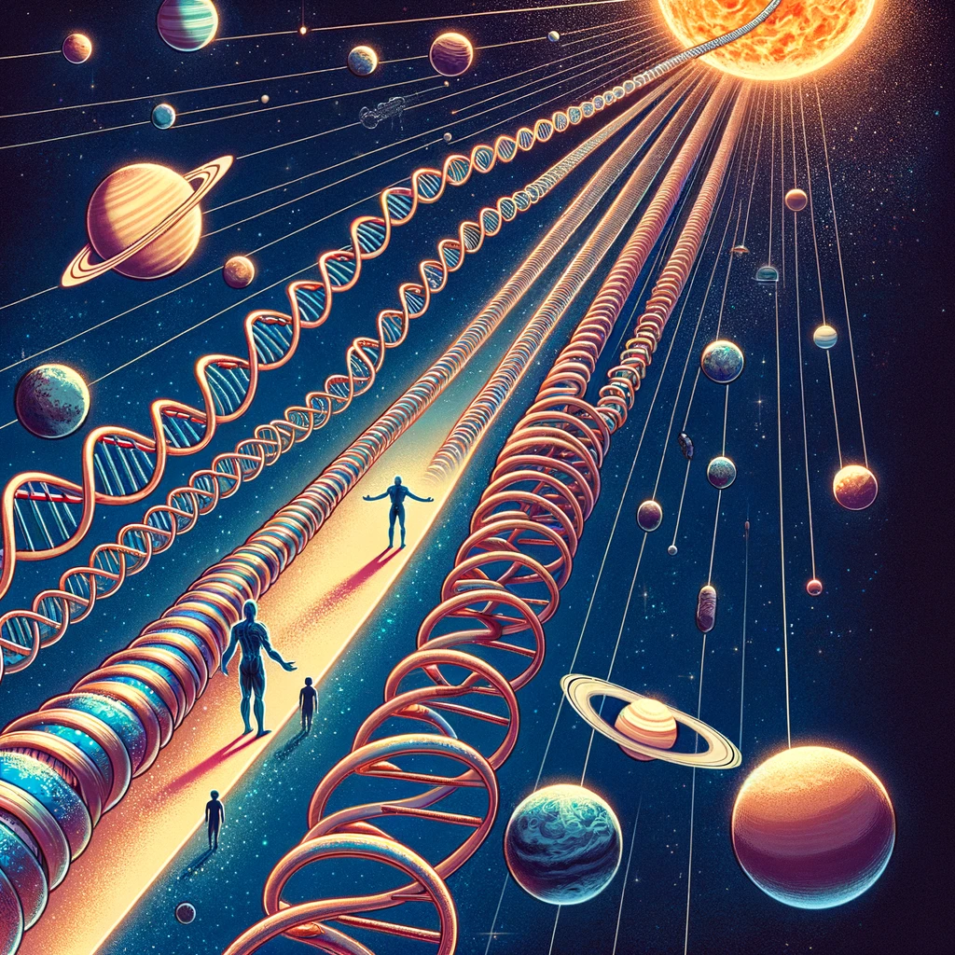
Unpacking the body
Atoms in body - 7,000,000,000,000,000,000,000,000,000 - seven octillion
Lungs - the size of tennis court !!
Length of all your blood vessels - two and half times around the earth !!
Airways - Stretch from London to moscow !!
Entire DNA - Distance beyond pluto!!
Stable for thousands of years !!!
One error in a billion bases !!!
Adapted from The body by Bill Bryson

Slide 3
Central dogma of biology
.
Proposed by Francis Crick in 1958
Flow of genetic information within a biological system
Basis for understanding the processes of gene expression and regulation

Slide 4
Central Dogma of Molecular Biology
Transcription
Translation
DNA
RNA
Protein
Code remains almost same
Language changes

Slide 5
Importance of the Central Dogma
Framework for Understanding Genetic Information Flow from DNA to RNA to proteins - development, functioning, and reproduction of all living organisms.
Basis for Molecular Genetics: to understand how genes are expressed and regulated- development of genetic engineering, gene therapy, and the CRISPR-Cas9 gene-editing technology.
Insights into Evolution: The conservation of these mechanisms across diverse forms of life highlights their importance in the evolution of biological systems.
Medical Research and Diagnostics: identifying the genetic basis of diseases, better diagnostic tools, treatments, and the development of personalized medicine.
Biotechnology and Synthetic Biology: design of synthetic genes to produce new proteins with desired functions- medicine, agriculture, and industry eg insulin, growth hormones, and biofuels.
Understanding RNA's Role - new fields of research and therapeutic strategies.

Slide 6
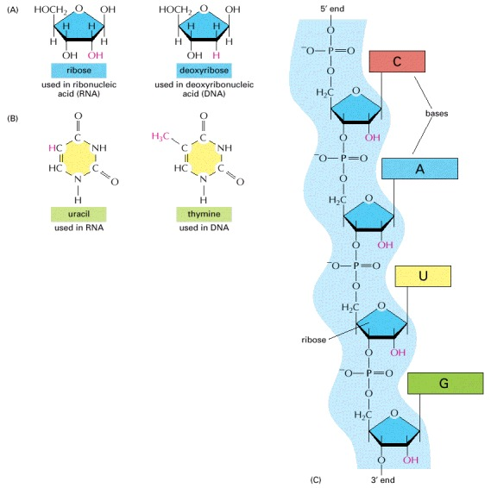
RNA

Slide 7
Why do you need DNA when you have RNA?
RNA world Hypothesis

Slide 8
Types of RNA
messenger RNA (mRNA): carries information from DNA to the ribosomes
ribosomal RNA (rRNA): incorporate into the ribosomes
transfer RNA (tRNA): transfer specific amino acids to growing polypeptide chains
small nuclear RNA (snRNA): splicing of introns from primary genomic transcripts
microRNA (miRNA) – regulate gene activity; regulate the expression of mRNA
small nucleolar RNA (snoRNA): Involved in post transcriptional modification
long non-coding RNA (lncRNA): longer than 200 nucleotides without protein-coding potential and function
catalytic RNA (ribozymes) -which functions as an enzymatically active RNA molecule

Slide 9
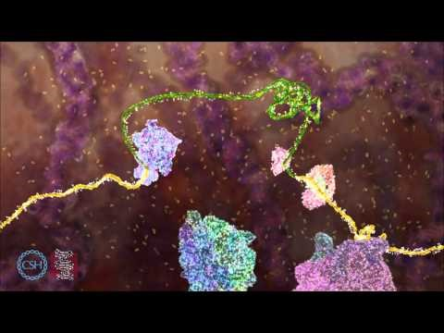
https://www.youtube.com/watch?v=9kOGOY7vthk

Slide 10
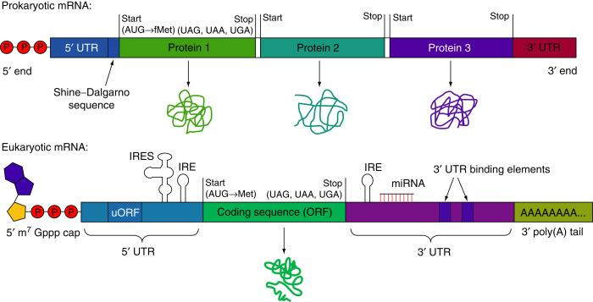
Difference between pro & eukaryotic RNA

Slide 11
https://media.hhmi.org/biointeractive/click/genetic-medicine-interactive/

